Slide 1
Solution Overview
  The CCH Tagetik Intelligent Platform
  Solution Differentiators & Benefits
  Customer Testimonial
  FUD
  Strengths & Weaknesses

Slide 2
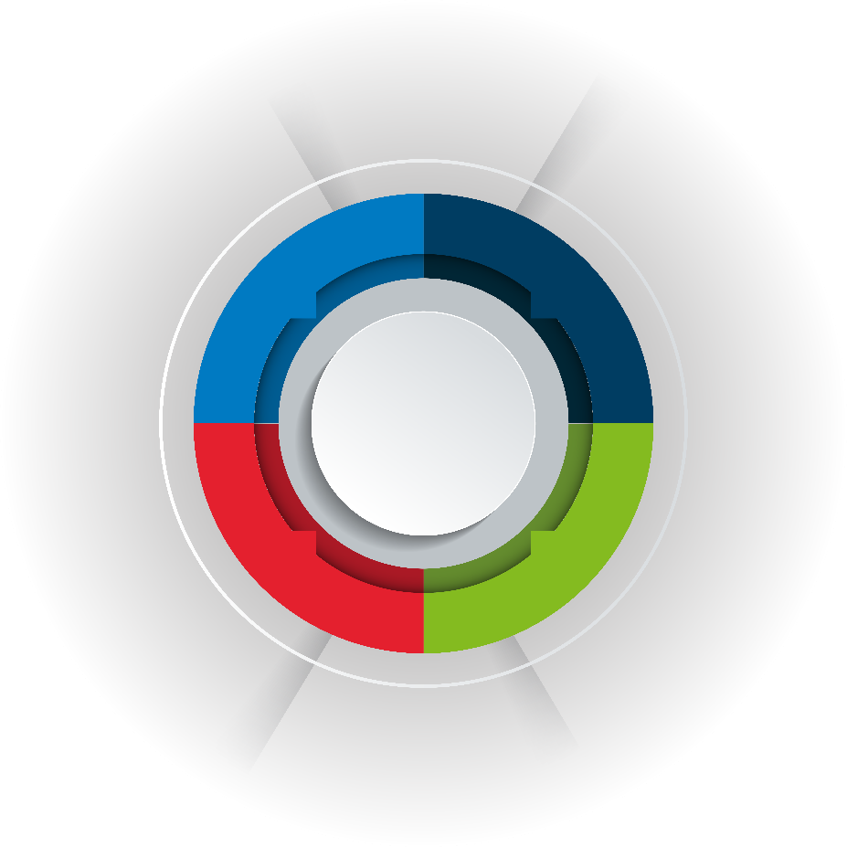
CCH Tagetik: a Unified, intelligent platform for the CFO Office
INTELLIGENT ANALYTICS & ASK AI
Financial Close & Consolidation
Extended Planning
Transaction Matching
Account Reconciliation
Consolidation
Financial & Management Reporting
Disclosure Management
iXBRL
Financial Planning
Operational planning
Integrated Business Planning
Supply Chain planning
Industry-specific solutions
CCH® Tagetik Intelligent Platform
Corporate tax
ESG & Regulatory
Global Minimum Tax
Country-by-Country Reporting (CbCR)
Tax Provision and Reporting
Other Tax
ESG & Sustainability Reporting
ESG Planning
Lease Accounting (IFRS 16 & ASC 842)
IFRS 17 Insurance
Solvency II (Pillar I, II, III)
EBA Supervisory reporting
Data
Connectivity Services(APIs)
Financial Intelligence
Auditing & Data Lineage
Advanced Security & Compliance
Learning Hub
Data Hub Services (AIH)
Artificial Intelligence
Notes:
CCH Tagetik is an intelligent, unified platform tailored to support the Office of the CFO with financial, operational, and regulatory tasks. It simplifies complex processes, empowering smarter decision-making and increasing productivity across the organization.
Our solution is characterized by two key aspects:
A Comprehensive Platform:
CCH Tagetik is more than a point solution for Planning or Consolidation—it’s a one-stop-shop for all finance-related processes. It goes beyond core financial functions to cover adjacent areas, leveraging a unified interface, consistent data sets, and a seamless user experience across all modules. From Financial Reporting to ESG Reporting, and from GL-level planning to supply chain planning at the SKU level, everything is integrated within a single solution.
Built-In Financial & Artificial Intelligence:
CCH Tagetik is designed with deep financial intelligence, understanding concepts like Balance Sheets, Profit & Loss statements, and advanced consolidation methods like the Equity Method. It also embeds artificial intelligence throughout the platform to enhance data accuracy through tools like Anomaly Detection and Auto Mapping, and boost productivity with features like AI-driven predictive planning.
Now, let’s go deeper into the platform's structure and functionality to see how it operates and is organized.

Slide 3



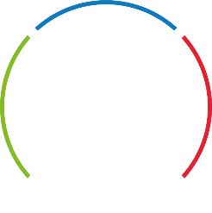


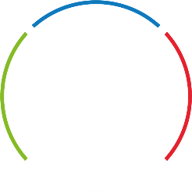
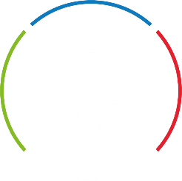




Components of the CCH Tagetik Intelligent Platform
CCH Tagetik
Intelligent Platform
Intelligent
Insights
Ask AI for Generative AI
Intelligent Analytics for Dashboarding
Intelligent
Solutions
Intelligent Disclosure for Narrative Reporting
Financial Close
& Consolidation
Account Rec.
JE Management
IC Management
Roll forward Schedules
Group Consolidation
Multi-GAAP reporting
Extended
Planning
LRP, Budgeting & Rolling Forecasts
Sales, HR, Opex, Capex, Project Planning
Demand & Supply Chain planning
Cash Flow Planning
Corporate Tax
ESG & Regulatory
Group Tax Provision and Reporting
Global Minimum Tax
Country-by-Country Reporting (CbCR)
Other Tax
ESG & Sustainability Reporting
Lease Accounting (IFRS 16 & ASC 842)
IFRS 17/LDTI Insurance
Intelligent
Services
Objective AI Services
AI Automapping
AI Anomaly detection
AI Transaction Matching
AI Driver
Based Intelligence
Predictive Intelligence
Data Hub layer (AIH)
Connectivity layer (APIs)
Notes:
Our intelligent platform is built on three core pillars:
Intelligent Services
This foundational layer comprises a suite of "services" that power various components of the application. These include:
Connectivity Services: to seamlessly integrate with over 250 source and target systems through standard APIs, pre-built connectors, or ad hoc ETL jobs, ensuring smooth and fast data flows
Data Hub services: A robust data repository, referred to as AIH – Analytic Information Hub, designed to handle massive volumes of operational and financial data, enabling advanced transformations, modeling, and the integration of non-financial data for deeper insights.
AI Services: A set of advanced AI-powered capabilities, such as AI Anomaly Detection, AI Automapping, Predictive Intelligence, and other machine-learning-driven tools, which enhance accuracy, automate tasks, and provide actionable insights across all modules.
These intelligent services form the backbone of the platform and power the second core pillar of our Intelligent Platform
Intelligent Solutions
This pillar encompasses the essential business processes that define the CFO’s office, designed to simplify and enhance workflows for:
Augmented Close & Consolidation: elevates the close process by going beyond traditional consolidation capabilities. This approach integrates automation, advanced analytics, and AI-powered tools to streamline workflows, build audit-defense, and reduce cycle times.
.Extended Planning: enables comprehensive financial and operational planning by seamlessly managing top-down long-range planning, bottom-up budgeting, and rolling forecasts. This includes sales, HR, OPEX, CAPEX, project planning, demand planning, and cash flow forecasting. With the integration of predictive analytics, the platform enhances planning accuracy by identifying trends and enabling proactive adjustments. Supporting both zero-based and driver-based planning approaches, it provides the flexibility and precision needed to align plans with strategic objectives and adapt to changing business condition
Corporate Tax: Provides comprehensive support for group tax provision and reporting, global minimum tax, and country-by-country reporting (CbCR).
ESG & Regulatory Reporting: Addresses sustainability reporting, and regulatory reporting in the areas of lease accounting (IFRS 16 and ASC 842), and other regulatory requirements
Intelligent Disclosure: produces seamless narrative reporting by combining financial data and textual content into professional outputs such as Word-based Annual Reports, 10Q/10Ks, and PowerPoint Board Presentations. Powered by Generative AI, it automates the creation of narratives, ensures consistency, and accelerates report preparation while enhancing accuracy and compliance.
These solutions are tailored to address the most complex needs of modern finance, driving efficiency, compliance, and insight.
Intelligent Insights
After integrating, processing, and enhancing data through our Intelligent Services and Solutions, the final step is leveraging this data for meaningful insights. The Intelligent Insights pillar provides powerful, self-service dashboarding and reporting tools to visualize and analyze data in real time. These tools are supercharged by Generative AI through our very own Ask AI, the intuitive CCH Tagetik companion that enables users to create reports and dashboards in natural language. Whether you're exploring data trends or generating comprehensive narratives, Ask AI makes it simple and accessible for all users.
Together, these three intelligent pillars—Services, Solutions, and Insights—form the CCH Tagetik Intelligent Platform, delivering end-to-end support for finance professionals, from data integration to decision-making, ensuring higher productivity, accuracy, compliance, and strategic value every step of the way.
From a CFO’s perspective, the CCH Tagetik solution covers the entire workflow of the finance office – NEXT SLIDE

Slide 4
Covering all financial, tax and operational processes
PRE-CLOSE
CLOSE
CONSOLIDATE
COMPLY
PLAN
REPORT
Key Benefits for You
Strategic Planning
Disclosure Mgmt., MD&A, Board Books
Eliminate disparate solutions or separate legacy instances
One-stop-shop for all Finance-owned processes​
Support future growth and increased business complexity
Expand at your own pace
Faster Time to Value and Buy-in from End Users
Integrated Financial Planning
Data Integration (Multiple GLs)
Lease Accounting
Trial Balance Validation
Ownership Structure
ESG Compliance
Annual Budgeting
Financial Reporting
Insurance Accounting
Group close Workflow
Budgeting
Account Reconciliation
Multi-GAAP Consolidation
Direct Tax Compliance
Transfer Pricing
Transaction Matching
Currency Conversion
Rolling Forecasts
Management Reporting
Performance Reporting
Indirect Sales & Use Tax Compliance
Profitability Modeling
Allocations
Solvency II
Demand & Supply Chain Planning
Ad Hoc Smart Insights
Indirect Tax Determination
Tax Provisioning
Month End Workflow Closing Tasks
ESG KPI Consolidation
EBA Supervisory Reporting
Driver Based & Zero- Based Planning
Data Visualization, Power BI, SAC, Qlik
CoA Homogenization
Journal Entry
iXBRL
IBP - Sales, HR, Opex, Capex & Project
ESG Reporting
Intercompany Matching & Eliminations
Global Minimum Tax Requirement
COGs Planning
Movement & Continuation Schedules
ESG Planning
Tax Provisioning
Balance Sheet & Cash Flow Planning
Predictive Planning (AI/ML)
AI-powered Services
Notes:
CCH Tagetik empowers our customers to seamlessly extend their capabilities across the entire CFO workflow, supporting them at every step of their financial, operational, and regulatory processes. Our unified platform provides a comprehensive 360-degree view of their organization while enabling them to automate and extend to areas they may not have initially envisioned—all without compromising their most pressing priorities.
With our CCH Tagetik Intelligent Platform, our customers can extend their workflows across all major finance activities:
Pre-Close Activities
We streamline pre-close tasks by enabling journal entries to flow back into ERP systems through semi-transactional solutions like lease accounting and insurance accounting, ensuring accuracy and integration with upstream processes.
Closing Books with Confidence
Our platform simplifies the close process, whether monthly, quarterly, or annual, with workflow-oriented solutions for intercompany eliminations, allocation entries, transaction matching, and journal management. This gives customers confidence in their data and reporting.
Consolidation
CCH Tagetik acts as a trusted financial companion, leveraging built-in financial intelligence to handle complex requirements like currency translation, multi-GAAP reporting, and sub-consolidations, ensuring compliance and precision.
Ensuring Compliance
We help build a solid audit defense through our robust regulatory and tax offerings, including ESG reporting, Pillar II compliance, corporate tax, and indirect tax. Customers can rely on our solutions to navigate evolving compliance demands effortlessly.
Forward-Looking Planning
Our planning solutions empower customers to look ahead, offering tools for everything from high-level executive strategies to detailed operational and financial plans. These plans are seamlessly integrated across departments, enabling a unified approach to decision-making.
Reporting and Analytics
CCH Tagetik delivers powerful reporting capabilities, including self-service analytics, narrative reporting, financial and management reporting, and ad-hoc dashboards with robust data visualization. These tools allow users to evaluate and act on insights with ease.
By extending beyond the most traditional and core areas of the CFO Office within the unified CCH Tagetik platform, Finance professionals can rely on:
Reduced Complexity: A unified platform eliminates the need for disparate systems, reducing IT maintenance costs and ensuring seamless data flows across all processes.
Single Point of Access for Finance: By consolidating critical finance activities into one platform, we empower finance teams to manage end-to-end processes without needing to navigate multiple systems.
Future-Proof Scalability: As organizations grow or face new challenges, CCH Tagetik scales effortlessly to accommodate more users, data, and workflows, making it a reliable solution for navigating change and expansion.
Expansion at Your Own Pace: Our modular design lets customers adopt new functionalities as needed, ensuring they can align their growth with their specific business priorities and resources.
Faster Time-to-Value and User Adoption: With a user-friendly interface and built-in intelligence, the platform accelerates implementation and drives quick wins. Minimal training is required, and users benefit from an intuitive experience that fosters engagement and satisfaction.
AI-powered services: Leverage AI to enhance productivity, increase data accuracy, and deliver actionable insights, empowering finance teams to work smarter across the application.
While flexibility to extend into adjacent processes and address additional complexity is essential, flexibility without control can lead to chaos. That’s why it’s crucial to ensure that the solution’s extensibility does not compromise corporate governance.
We call it CONTROLLED AGILITY – NEXT SLIDE

Slide 5
Extensibility requires Governance: CONTROLLED FLEXIBILITY
Extensibility refers to the ability for a Finance System to be extended beyond its original scope to address additional, unique requirements in addition to what was initially configured, within the same instance and without requiring any re-work
No compromise on Governance
Controlled Flexibility
Refers to the flexibility of extending to adjacent financial or operational processes without compromising on the overall Corporate Governance
Notes:
The key is achieving a balance between the flexibility to extend beyond the original scope to meet the specific needs of local operating units or any operational requirement, while maintaining the control and governance required by the Central Finance Team.
For example, we have customers that
Begin with Financial Consolidation and extend to Planning: Initially, they bring in trial balances for consolidation with minimal dimensional detail. Over time, they decide to expand their intercompany elimination processes to the invoice level through transaction matching or extend their efforts to include budgeting and planning, requiring the addition of new dimensions—all within the same solution.
Focus on Financial Reporting first and extend to ESG reporting afterwards: Initially, the scope may focus on producing standard financial statements. Over time, as ESG initiatives grow in importance, the same solution can seamlessly extend to accommodate operational reporting for sustainability purposes. This includes integrating non-financial data and aligning with ESG frameworks, all while maintaining consistency and governance within the unified platform.
Start with Standard Financial Planning and extend to Operational Planning: Some customers adopt the solution for corporate-level financial planning and later extend its use to local business units. This requires a more analytical setup with additional drivers, accounts, dimensions, and calculations tailored to local needs.
In every scenario, the CCH Tagetik Intelligent Platforms provides Flexibility with Governance:
The ability to start where you need to start, focusing on the most pressing priorities first.
The flexibility to extend to additional processes or adjacencies as your organization’s needs evolve.
The assurance of maintaining a governance framework where all new models connect back to a common denominator, preserving control and consistency across the organization.
CONTROLLED FLEXIBILITY is exactly that: the flexibility to extend to adjacent financial or operational processes without compromising on the overall Corporate Governance.
Let me give you an example that is easy to follow:

Slide 6

CCH Tagetik: Flexibility with Governance
Controlled Flexibility
Global framework
COMMON DATA MODEL
STANDARD REPORTING FORMULAS
DRILL THROUGH TO ANALYTICAL LAYER
Governance at the
Global level
Dedicated Analytical Information Hub Layer with ad-hoc dimensions for detailed operational needs
PREDEFINED
Traditional financial layer for standard dimensions and for aggregated corporate data analysis & reporting
Division 1
Division 2
Division 3
Division 4
DIVISION-SPECIFIC DATA MODEL
DIVISION-SPECIFIC MODELING
DIVISION-SPECIFIC REPORTING
AD HOC
Flexibility at the
Local level
Localized workspaces
Notes:
Imagine a multi-industry or multi-product enterprise, much like Wolters Kluwer. Globally, the organization operates through five distinct divisions, each offering a variety of products across multiple business units.
During the budgeting season, every division and business unit needs to plan sales for its respective products. However, given the diverse markets and customers they serve, each division has its unique drivers, calculations, and assumptions to estimate sales effectively.
At the same time, Corporate Finance at the global level requires a unified framework—a common language that ensures consistency across all divisions at a more aggregated level while retaining the flexibility to drill into divisional details when needed.
CCH Tagetik provides exactly this:
Flexibility at the Local Level: Each division can operate within its own localized analytical layer, tailoring dimensions, assumptions, calculations, and reports to meet its specific needs. Division 1 can set its own drivers and metrics, as can Divisions 2, 3, and 4, ensuring that each has the tools necessary to reflect its unique business context.
Governance at the Global Level: Simultaneously, CCH Tagetik enforces a global framework of standardized dimensions and reporting formats. This ensures that Corporate Finance maintains consistency and comparability across divisions. The platform allows aggregation at the corporate level while preserving the ability to drill down into the detailed, division-specific data when required.
This approach, powered by Controlled Agility, strikes the perfect balance between local flexibility and global governance. It empowers divisions to meet their specific planning needs while enabling Corporate Finance to maintain oversight and alignment across the entire organization.
This is not just a theoretical concept – our application is intentionally architected with this in mind to support flexibility without compromising governance – NEXT SLIDE

Slide 7
AIH: Analytic Information Hub
CCH Tagetik
Intelligent Platform
Predefined Data Model
Financial Intelligence
Aggregated Financials
Traditional layer for aggregated financial applications
Pre-configured standard dimensions (entity, account, period , scenario, etc)
Built-in financial to handle typical financial processes (currency conv, IC Elim. etc)
Typically hosting financial data at the TB / aggregated level
FINANCIAL LAYER
ANALYTICAL LAYER
An open, analytical data-hub for the CFO office extending the traditional financial layer to host massive amounts of operational data with sophisticated modeling & reporting capabilities.
AIH – Analytic Information Hub
Open Data Model
Data Scalability
Optimized Performance
Unlimited dimensionality and shared dimensions
Aims to host operational details at a very granular level of information to maximize traceability
Built for fast performance through columnar table approach, DB partitioning, table indexing, and parallel querying
Powerful Data Transformation
Advanced ad-hoc Modeling
Connecting Finance To Ops.
Integrate, collect, normalize and transform data
Low code approach for most complex calculations
Natively integrating financial and operational models
Data Integration
Notes:
Architecturally, the CCH Tagetik platform is designed with two logical layers, each serving distinct yet complementary purposes:
The Financial Layer is the traditional layer designed for core financial applications, such as consolidation, financial planning and financial reporting. It relies on a predefined set of intelligent dimensions common across all implementations, such as the Entity and Account dimensions. Embedded with built-in financial intelligence, this layer is capable of handling complex financial processes, including balance sheet versus profit and loss account differentiation, currency conversions, intercompany eliminations, and more. Given its focus on financial processes, the Financial Layer typically hosts aggregated data at the Trial Balance level. It provides a structured framework to address the most standard and critical requirements of traditional financial processes
The Analytic Information Hub Layer (AIH) extends the financial layer beyond the traditional financial processes. AIH serves as an analytical data hub within the same CCH Tagetik platform. Dedicated to the Office of the CFO, AIH is designed to handle massive volumes of data while maintaining high performance. Unlike the Financial Layer, AIH is based on unlimited dimensionality and comes equipped with advanced data transformation and data modeling capabilities. It is particularly suited for operational models that require data scalability and complex calculations, making it a powerful tool for extending finance’s reach into operational insights without sacrificing speed or reliability.
For instance, in a planning application, it may be necessary to plan personnel costs at the employee level for greater accuracy. In such cases, AIH can host detailed payroll data at the employee level, which inherently includes various operational attributes such as hire date, anniversary date, merit increase percentages, insurance plans, and more. To accommodate this, AIH incorporates the Employee as an operational dimension.
However, when it comes to financial reporting at the P&L level, it is unlikely that an income statement would be generated at the employee level. Instead, the Financial Layer, which is designed for aggregated financial reporting, typically does not include the Employee dimension.
In this scenario, the CCH Tagetik platform bridges the gap by hosting detailed operational data in the Analytical Layer (AIH) to perform complex calculations, such as payroll tax computations, while aggregating the results for financial reporting in the Financial Layer. This allows the platform to produce a P&L at the GL Account level, such as "Salary and Wages," while still enabling users to drill down into the Analytical Layer if needed to access granular details at the employee level.
The Financial and Analytical two layers are natively integrated within the CCH Tagetik Platform, allowing users to extend beyond traditional financial processes to meet operational requirements. The Analytical Layer (AIH) provides the flexibility needed for granular, data-intensive operations, while the Financial Layer ensures that the core financial framework remains consistent and reliable.
Together, they empower organizations to address both financial and operational needs seamlessly, maintaining a balance between flexibility and governance

Slide 8
CCH Tagetik Solution Differentiators
1
One Extensible Intelligent Platform
2
Controlled Flexibility
3
Certified to run natively on SAP HANA
PLATFORM: One single solution for all your financial and operational needs organically developed within the solution (no 3rd party apps, add ons, etc)
EXTENSIBILITY: Only EPM solution to feature a finance-focused data lake (AIH) embedded within the platform with unlimited dimensionality to go beyond traditional Financial needs and host high volumes of financial and operational data
INTELLIGENCE: holistic approach to financial and artificial intelligence as a service holistically supporting any solution
Only EPM solution architecturally designed to offer the Flexibility of extending to adjacent financial or operational processes without compromising on overall Corporate Governance
Not just purely integration with SAP. CCH Tagetik is the only non-SAP EPM solution that is certified to run natively on SAP HANA.
Notes:
ONE EXTENSIBLE INTELLIGENT PLATFORM
You’ve likely heard other vendors claim they provide a unified platform for the office of the CFO. But let me explain why CCH Tagetik is truly different as a comprehensive Finance Transformation Platform.
First, unlike solutions that rely on third-party apps or add-ons, CCH Tagetik is a single, unified platform that seamlessly integrates financial and operational processes. We don’t depend on a marketplace filled with apps developed by third-party system integrators, which can quickly fall out of maintenance or require heavy customization in production. Instead, our platform is developed organically, continuously expanding to new financial and operational areas while maintaining the integrity of a single solution.
Second, our platform truly extensible. While other vendors might use the term, CCH Tagetik stands out as the only EPM solution offering an embedded business data lake, known as AIH. This finance-focused data lake, with its open data model and powerful data-handling capabilities, allows customers to extend the platform’s functionality well beyond traditional financial needs. Whether it’s operational data or advanced analytics, our platform is purpose-built to scale and evolve.
Lastly, when it comes to intelligence, our approach is enterprise-grade and far more expansive than the limited, case-specific AI functionality you’ll find with other vendors. AI in CCH Tagetik is not confined to a single app or feature—it’s a pervasive service that enhances the entire platform. For example, you can use AI in Close & Consolidation for transaction matching, in Budgeting for predictive planning, or for anomaly detection in Data Quality. Our AI capabilities are horizontally integrated, serving multiple functions and delivering value across the enterprise.
CONTROLLED FLEXIBILITY
Flexibility is a term everyone likes to use, but we believe flexibility without governance leads to chaos. With CCH Tagetik, you can extend into adjacent financial and operational processes without sacrificing rigorous corporate governance. This means you can adapt to changing conditions, innovate confidently, and grow your business—all while maintaining compliance and control. By balancing agility with governance, our platform empowers organizations to confidently move forward, ensuring both innovation and operational integrity.“
CERTIFIED TO RUN NATIVELY ON HANA
Finally, we are proud to be the only non-SAP solution in the Corporate Performance Management space that is certified to run natively on SAP HANA. While other solutions can integrate with SAP, which is expected of any enterprise-grade software in 2025, CCH Tagetik goes a step further. We don’t just integrate—we run natively on HANA. This certification by SAP itself sets us apart, ensuring unparalleled performance, scalability, and seamless alignment with SAP investments."
ONE EXTENSINBLE INTELLIGENT PLATFORM
You might have heard from other vendors that they also provide a unified platform for the office of the CFO but here is why CCH Tagetik is different as a true Finance transformation Platform:
First off unlike solutions that depend on third-party apps or add-ons, CCH Tagetik is built as a single, unified PLATFORM that seamlessly integrates all financial and operational needs. We do not use apps from a markrtplace developed by some third party system integrator that then gets out of maintenance or needs heavy customization when in production,. Our development efforts are organic and we expand to new financial and operational areas within the same solution thanks to our analytical later.
Secondly, our platform is EXTENSIBLE and you might have heard that word from other vendors as well but we are the only EPM solution in the market offering an embedded business data lake, called AIH that, with its open data model and robust data-handling capabilities, enables customers to extend the application’s functionality beyond traditional financial requirements. We are natively built for that.
Lastly while many vendors talk about AI functionality, their AI capabilities are often tailored to specific use cases. Our approach to AI instead is different and more enterprise-grade. AI is a pervasive service that supports the entire organization solution, enhancing all areas of the platform. You can active AI in close and consolidation for AI-powered transaction matching ior use AI in Budgeting for to predictive planning or leverage AI for anomaly detection in data quality. Our AI capabilities are not confined to an app but are designed to serve multiple functions horizontally across the enterprise.
CONTROLLED FLEXIBILITY
Every body likes to say they need flexibility but we are convinced that flexibility without some sort of governance equals chaos. CCH Tagetik offers the unique ability to extend into adjacent financial and operational processes while maintaining rigorous corporate governance standards. This ensures businesses can adapt quickly to changing conditions without compromising control or compliance. By providing this balance of agility and governance, the platform positions itself as an enabler of growth, allowing businesses to confidently innovate while maintaining operational integrity.
CERTIFIED TO RUN NATIVELY ON HANA
Lastly, we are the only NON SAP solution in the world of Finance and Corporate Performance Management that is certified to natively run on HANA. While other solutions can INTEGRATE with SAP, which is a given for any enterprise grade software in 2025, we are the only Non SAP EPM vendor to not only integrate but actually RUN on HANA. And we are certified by SAP.

Slide 9
CCH Tagetik
Solution Benefits
Scale at your own pace
Expand to additional financial or operational processes when you need to, with the confidence that you'll never outgrow the capabilities of the solution
Embrace operational data
Harness the power of CCH Tagetik’s high-volume data scalability to seamlessly integrate operational data in your decision making process for increased accuracy
Continue your SAP investment
CCH Tagetik is non-disruptive of your IT strategy and builds on your current SAP landscape extending and maximizing the value of your SAP investment,
Notes:
1. Scale at Your Own Pace
"One of the key strengths of CCH Tagetik is its ability to grow with your business. You can expand into additional financial or operational processes as your needs evolve, without worrying about outgrowing the solution. This flexibility ensures that whether you're addressing immediate priorities or planning for future growth, the platform will always support your requirements. Our solution grows as your business needs grow and you never have to worry about outgrowing it (i.e.: if you have Anaplan for planning and then want consolidatuion, you need another solution. If you have OS for consolidation and want to do ESG you will need another solution).
2. Embrace Operational Data
"With the power of CCH Tagetik’s high-volume data scalability, you can seamlessly integrate operational data into your decision-making processes. This isn’t just about gathering more data—it’s about unlocking actionable insights that improve accuracy, efficiency, and strategic decision-making across the organization. By bringing operational data into the fold, you can gain a more holistic view of your business and make smarter, data-driven decisions."
3. Continue Your SAP Investment
"CCH Tagetik is designed to enhance and extend the value of your current SAP ecosystem. Unlike other solutions, it’s non-disruptive to your IT strategy, seamlessly integrating with your SAP landscape. Furthermore, as the only non-SAP solution certified to run natively on HANA, CCH Tagetik ensures maximum performance, scalability, and ROI, helping you continue to derive value from your SAP investment while building on it with advanced financial and operational capabilities."
Closing Statement:
"These benefits demonstrate how CCH Tagetik empowers your organization to scale effortlessly, unlock the potential of operational data, and maximize your existing IT investments—all while providing a future-ready platform for your financial and operational transformation."
Feel free to adjust the tone or emphasis based on your audience!
4o
O
ChatGPT can make mista

Slide 10
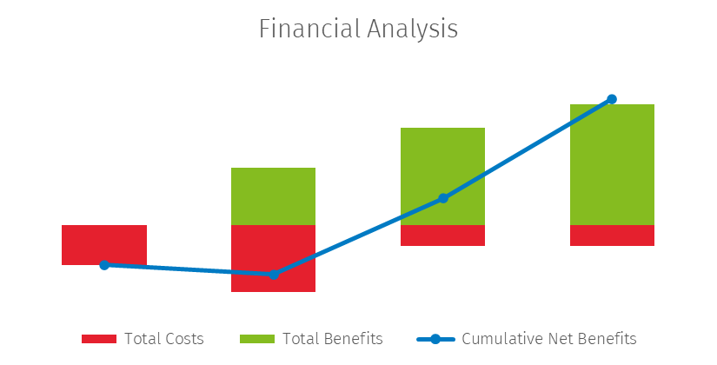
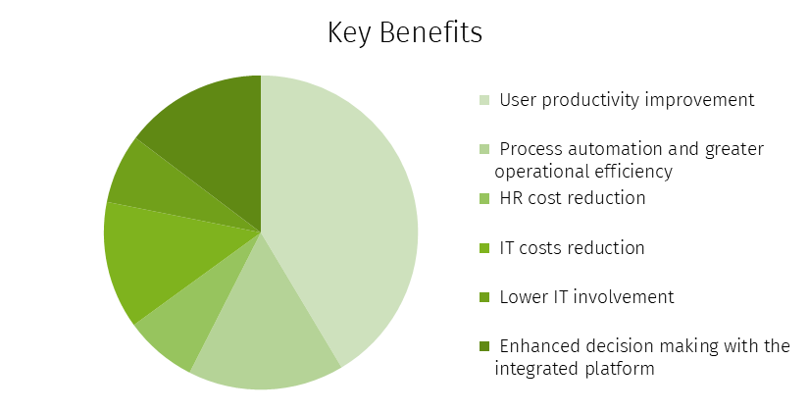
Typical Solution ROI
Medium-size manufacturing company. The company chose to invest in CCH Tagetik Budgeting, Planning and Forecasting and CCH Tagetik Financial Close and Consolidation on the cloud.
Tot Cost
$349,484
Tot Benefit
$599,317
NPV
$249,833
ROI
71%
Payback period
21 m
Net present value (NPV) is the difference between the discounted benefits and discounted costs
Cumulative net benefits indicate the cumulative total
The payback period indicates the length of time an investment reaches the break-even point and recovers its cost
Return on investment (ROI) is a profitability measurement expressed as the percentage of the NPV on the total discounted costs
Notes:
To put it in numbers, this is a study we recently conducted with a medium-sized manufacturing company that chose CCH Tagetik to automate their Planning and Consolidation processes.
You can see some of the key metrics on this slide, but the main takeaway is the return on investment they achieved, how quickly they saw value, and where that value came from.
In less than two years, they achieved an ROI north of 70%, driven primarily by productivity gains, better decision-making, and lower IT costs.
This is a clear example of how CCH Tagetik delivers measurable financial and operational impact—proving that the right investment in finance transformation pays off, both in efficiency and in bottom-line results.

Slide 11
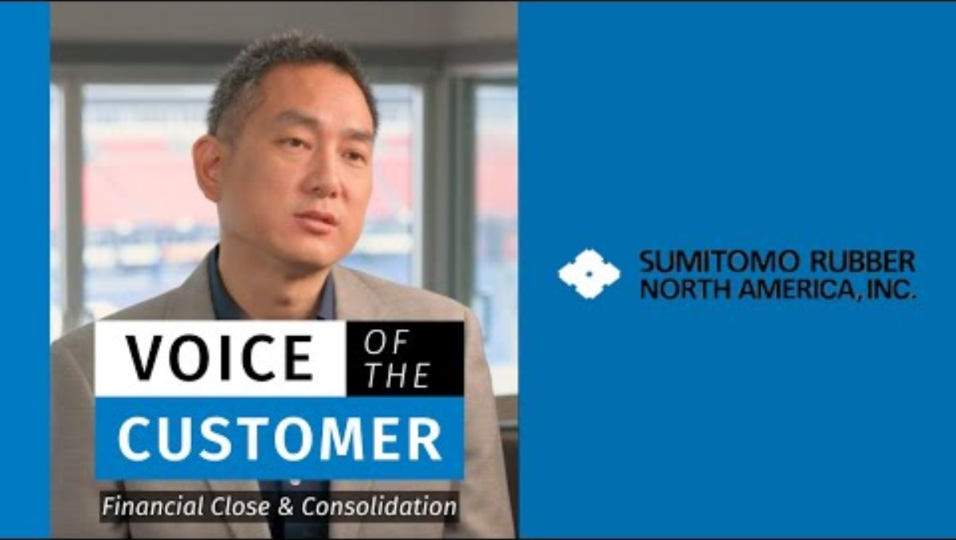
Customer Testimonial
“CCH Tagetik is of the few solutions out there that can do consolidation and planning and do them both very well”
https://www.youtube.com/watch?v=NbxQl0tuCf4&list=PLComc0Pb7UUPqflJ62LB9_k9eIIIYA7OK

Slide 12




CCH Tagetik Platform Case Study
CCH® Tagetik processes: GMT, Consolidation, Planning and Financial Reporting
CHALLENGES
DIFFERENTIATORS
ACHIEVEMENTS
Global alignment– Many disparate data sources and solutions created complexity to support a global view of consolidated financials. A unified enterprise solution was needed to truly merge the companies and provide consistent financial view of the new company.
Prior solutions were on-premise – lack of regular enhancements, costly maintenance, upgrades and technical support demanded need for a full featured Cloud based solution. Data integration to SAP ECC was a manual process with serious data validation challenges.
Ease of Reporting / Excel Interface – dynamic reporting reduces maintenance. Cash Flow and Intercompany reporting.
Financial Intelligence - no custom rules required and configurable by business users. Maintenance is simplified and cost savings.
Reporting Details - drill through details can be loaded and available from reporting without performance affect on consolidation processing time.
Flexible Data Loading/Automation – provided consistent integration to SAP ECC during Phase 1 and shifted connection to Central Finance in a subsequent phase
Cash Flow Automation- collection and automation of Balance Sheet movements to automate roll forward scheduled and cash flow reporting
Flexible Reporting – complex reporting views (previously manually generated) are easily accomplished and maintained: ie: GAAP, Mgmt to GAAP walk, IFRS.
Complex Tax Reporting – complex reporting views (previously manually generated) are easily accomplished and maintained: ie: GAAP, Mgmt to GAAP walk, Guarantor, IFRS.
Fully Automated Data Loads – automated, hourly data loads at transaction-level
Unified Solution for all divisions
Notes:
SUMMARY:
Keurig Dr Pepper replaced their legacy HFM system with CCH Tagetik to unify financial data across their Hot and Cold divisions. The platform's automation capabilities, particularly in cash flow reporting through automatic movements and roll-forward schedules, significantly reduced manual effort and improved data accuracy.
DETAIL:
Keurig Dr Pepper (KDP) replaced their legacy HFM system with CCH Tagetik, selecting it as the ideal platform to manage their consolidation and financial reporting needs.
The goal was to not only integrate financial data across the company’s Hot (beverage systems) and Cold (packaged beverages) divisions but also to automate and streamline critical processes such as cash flow reporting.
CCH Tagetik's unique capabilities proved instrumental in delivering these objectives.
With its intuitive, Excel-like interface and embedded financial intelligence, the platform enabled seamless integration obetween the two divisions. This provided KDP with a unified view of their consolidated financials, ensuring data accuracy and alignment across the organization.
A standout achievement of the project was the automation of cash flow reporting, which had previously required extensive manual effort. CCH Tagetik introduced automatic cash flow movements and roll-forward schedules, eliminating the need for manual adjustments and significantly reducing the risk of errors. This automation not only improved efficiency but also provided real-time visibility into cash flow, enabling faster and more accurate analysis for strategic decision-making.
Additionally, the solution streamlined reporting across all divisions, supporting complex requirements such as GAAP and IFRS compliance, statutory reporting, and ad hoc analysis. By unifying data and automating key processes, KDP gained a future-proof platform that could scale with the business and adapt to evolving regulatory demands.

Slide 13
Customers’ Voice
“A standout benefit of CCH Tagetik is its ease of use and the fact that it’s entirely finance-owned and maintained. When we have control over the software, it makes a big difference. As you dive into the system and explore its capabilities, you realize just how much it can do to drive business results. It’s a tool that empowers our finance team by putting the power directly in our hands, which is incredibly valuable for driving outcomes that align with our goals.”
Josh Issertell - Financial Planning & Analysis Manager, American Crystal Sugar Co.
"The key benefit of using CCH Tagetik has been our successful transition from a previous process that was no longer viable. After evaluating multiple vendors, we chose Tagetik for its greater autonomy and flexibility, which is essential given our company’s multiple divisions with distinct operational needs.”
Doug Collins - Director, Financial Systems Development, ScionHealth
"One of the main drivers for choosing CCH Tagetik was its breadth of product capability. We weren’t just looking for a solution for financial planning or consolidation; we needed a comprehensive platform for integrated business planning. CCH Tagetik aligns perfectly with our vision, encompassing financial, strategic, operational, and supply chain planning in one solution.”
Jessica Andal - IT Manager, Daktronics

Slide 14
Key reasons why organizations choose CCH Tagetik
Broad functional coverage
A comprehensive platform for the office of the CFO to cover all the most traditional and operational Finance processes, that grows as the business needs grow.
Solving for complexity
CCH Tagetik is purpose-built to handle complexity. Our unified platform simplifies sophisticated finance processes without compromising control, flexibility, or governance.
Technology leadership
CCH Tagetik's very own finance-oriented data mart (AIH) and its certification to run on SAP HANA allow companies to reach higher levels of data and performance scalability.
Roadmap and innovation
Constant focus on new product developments to increase productivity through AI-powered functionality, accuracy, and regulatory compliance.
User experience
CCH Tagetik prospects mention the ease of use, lack of intensive coding, and an enjoyable and modern user interface as key differentiators, especially when compared to legacy solutions.
Cultural fit
Cultural alignment, especially the transparency and authenticity of the extended CCH Tagetik sales team, is consistently recognized by prospects as a key factor driving the decision.

Slide 15
Common Questions & Competitive FUD
Robust but Complicated Solution
Due to its comprehensive functionality and wide range of features, implementing CCH Tagetik can be complex and time-consuming, especially for organizations transitioning from simpler tools or legacy systems. Gartner shows however that CCH Tagetik has the shortest implementation time for complex organizations.
Underlying Tables are in Italian
CCH Tagetik is a finance owned solution and while some original fact table names might still be in Italian, the vast majority of users—finance professionals, planners, and analysts—interact with CCH Tagetik through its intuitive and fully localized interface. They work with dashboards, reports, and workflows, not with database tables, making this point irrelevant to their experience.
Lack of Dashboarding capabilities
We have partnered with Microsoft PowerBI, the leader data visualization tool in the market, developing a seamless integration through the dedicated CCH Tagetik PowerBI connector so that CCH Tagetik data, metadata and security is automatically transferred to a PBI Cube. Additionally, in May 2024 we have released our Intelligent Insight solutions providing powerful, self-service dashboarding and reporting tools to visualize and analyze data in real time. These tools are supercharged by Generative AI through our very own Ask AI, the intuitive CCH Tagetik companion that enables users to create reports and dashboards in natural language.

Slide 16
Solution
Strengths & Weaknesses
Strengths | Weaknesses
Overall functional coverage of lateral processes within the same solution (GMT, Lease Accounting, AR, etc) | Ad Hoc Reporting (especially in case of HFM replacement and OS competes)
Strong Consolidation capabilities all around | Financial Reporting UI looks outdated
Native SAP Integration | Scenario management in Ppanning
AIH for high volumes of data scalability | Cumbersome modeling capabilities in Planning
Strong AI capabilities (yet to be fully productized) | Nascent data visualization capabilities
Disclosure Management & ESG Reporting | Performance for everyday tasks (report navigation, system navigation)
Allocations
Performance for heavy duty data processings (i.e. consol, allocations, etc) | The built-in approach required deep knowledge of system navigation
Advanced Excel Front End
Data Aggregation on the fly (no pre-calculated cubes)

Slide 17
Thank You

